Slide 1

COMPARISON OF INCREMENTAL ON LINE LEARNING ALGORITHMS FOR GESTURE AND VISUAL SMART SENSORS
Relator Davide Brunelli Co-relator
Andrea Albanese
Student Alessandro Avi

Slide 2


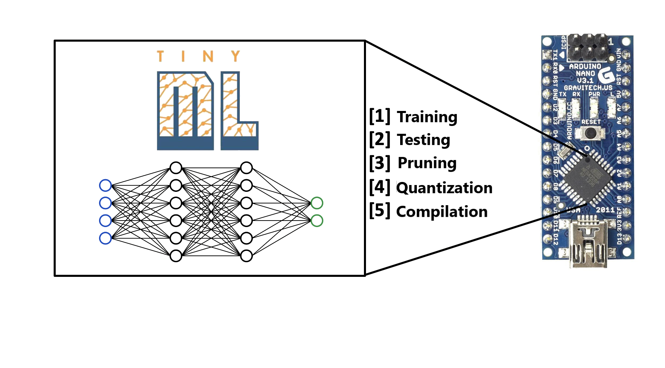
MACHINE LEARNING
Branch of artificial intelligence
Models are trained to predict, classify or learn from data
TinyML: application of ML on microcontrollers
1

Slide 3






TinyML IN IoT
IoT relies on the use of hundreds of devices as data harvesters
TinyML can be of great help for IoT applications:
Reduced size of data
Reduced amount of transmissions
Reduced energy consumption
Quicker response for real time app
BUT using ML comes with the cost of increased system complexity
One main drawback: model can ONLY perform inference
TRAINING
INFERENCE
DEPLOYMENT
2

Slide 4
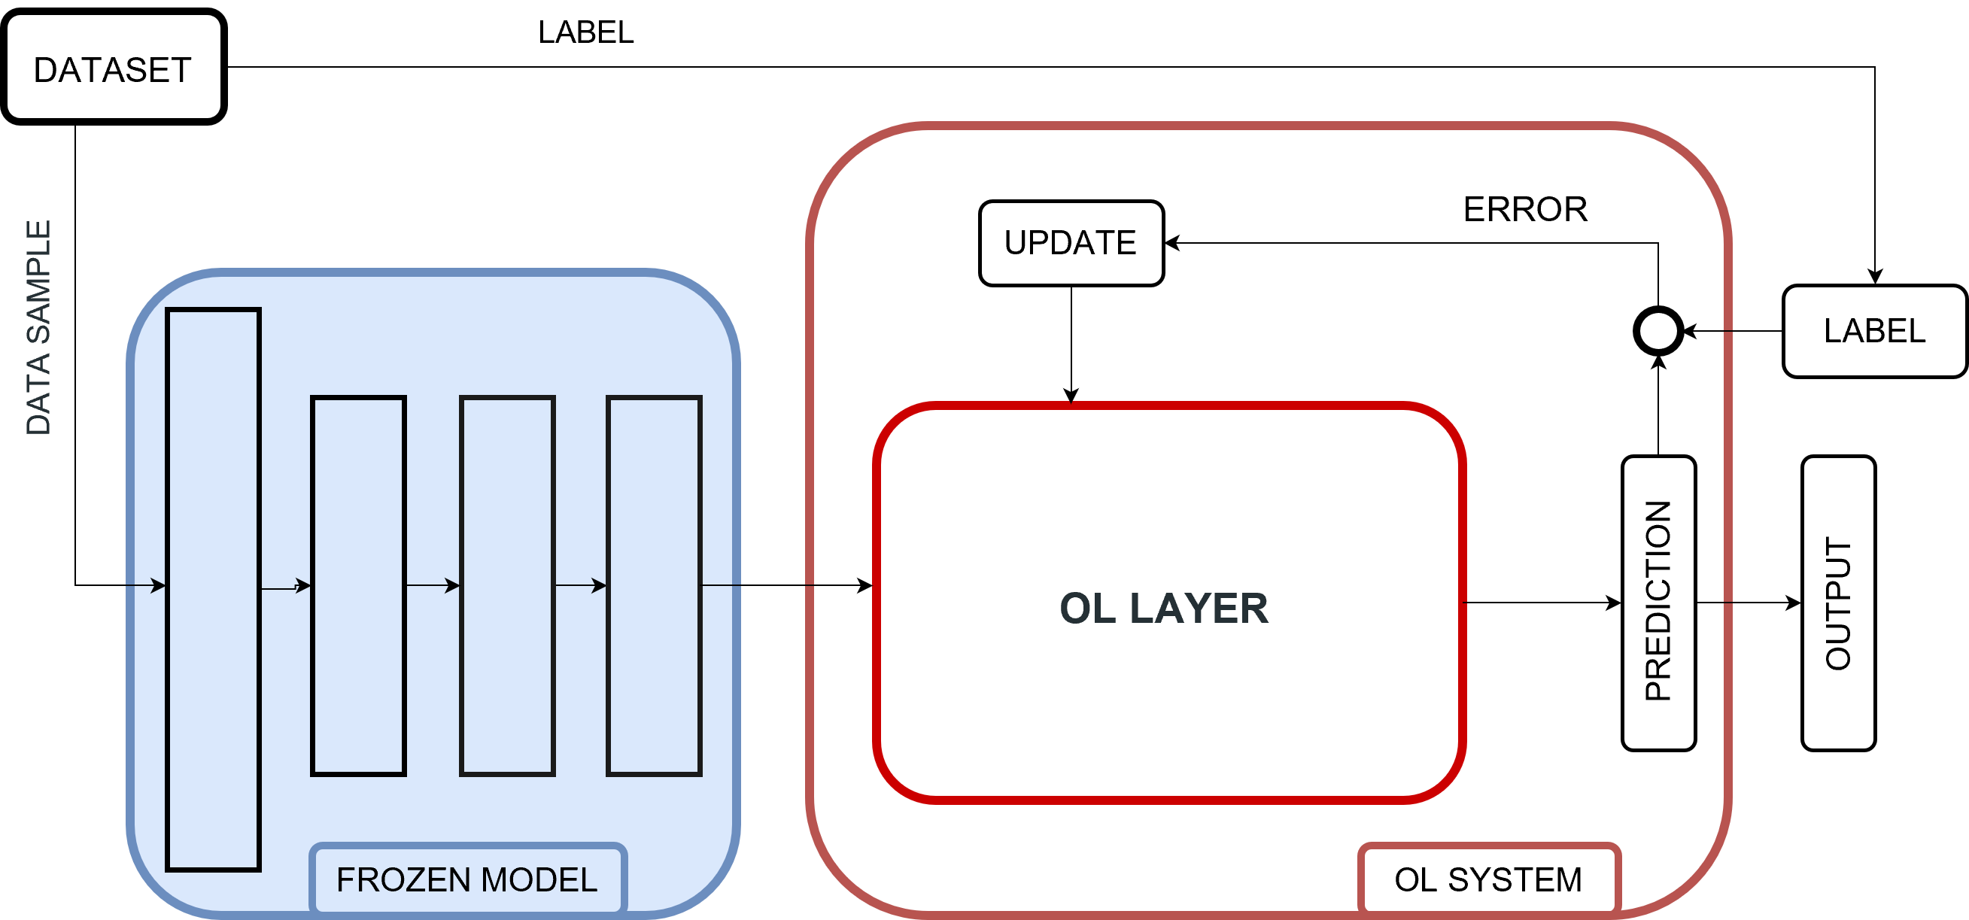
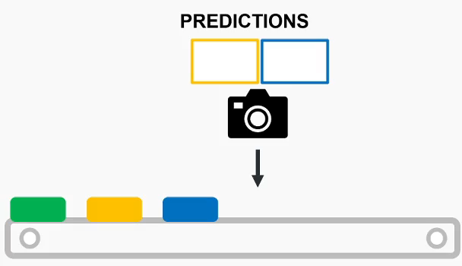
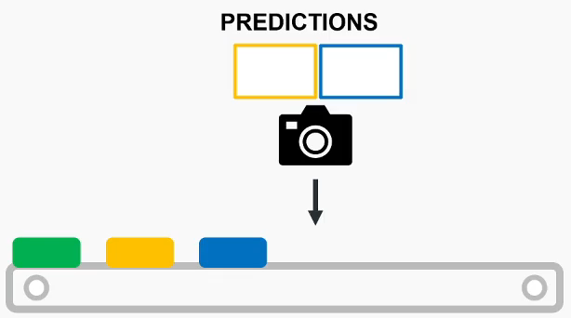
CONTINUAL LEARNING
Variation of machine learning that allows to:
Perform inference and train on the input received
Learn from the changes that affect the environment
Recognize, include and learn new classes
Example: visual inspection of defects in a production line
3
WITHOUT CONTINUAL LEARNING
WITH CONTINUAL LEARNING

Slide 5
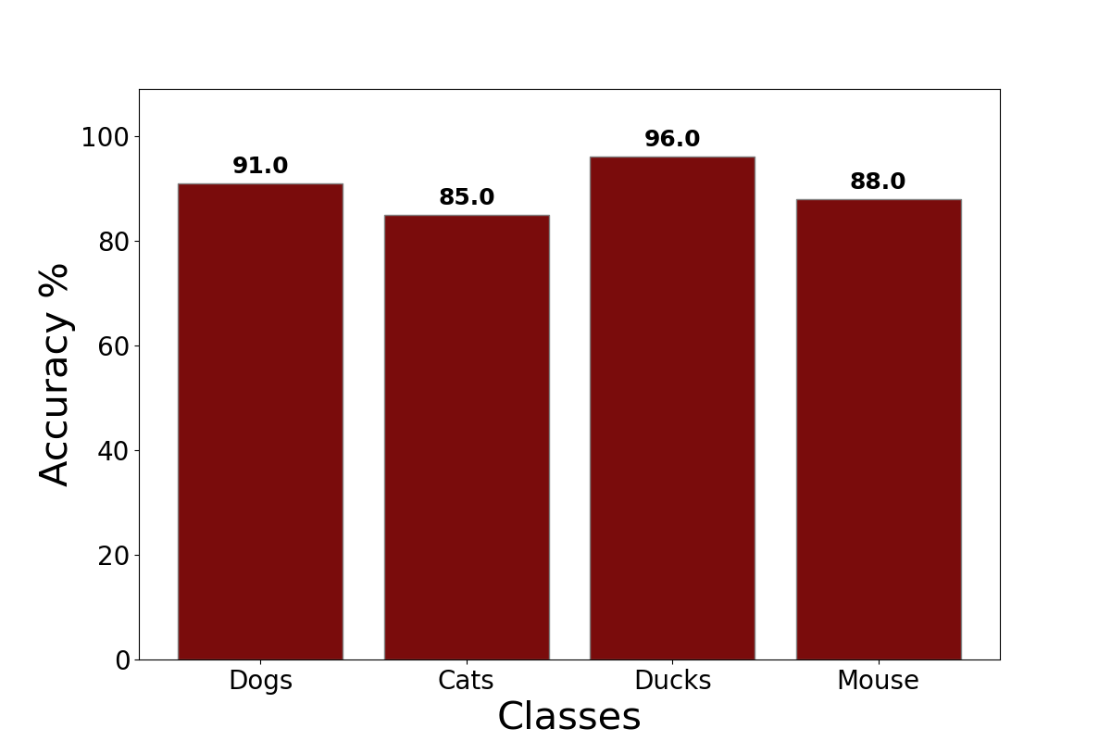
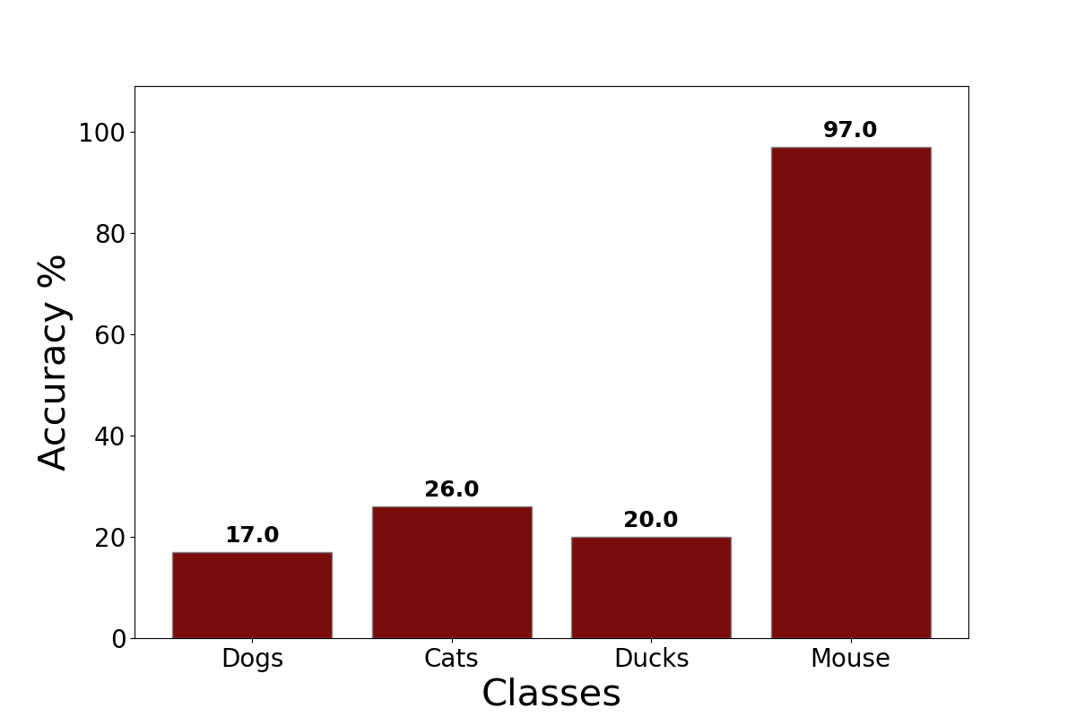
CATASTROPHIC FORGETTING
Direct consequence of continual learning
Phenomenon that is caused by overfitting over new data
Leads to models that can classify well new data but not old data
Model forgets its initial knowledge
4
MODEL PERFORMANCE BEFORE OVERFITTING
MODEL PERFORMANCE AFTER OVERFITTING

Slide 6
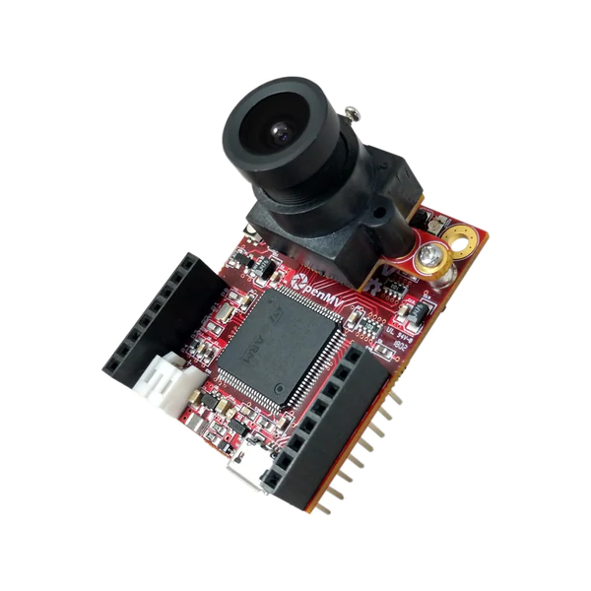
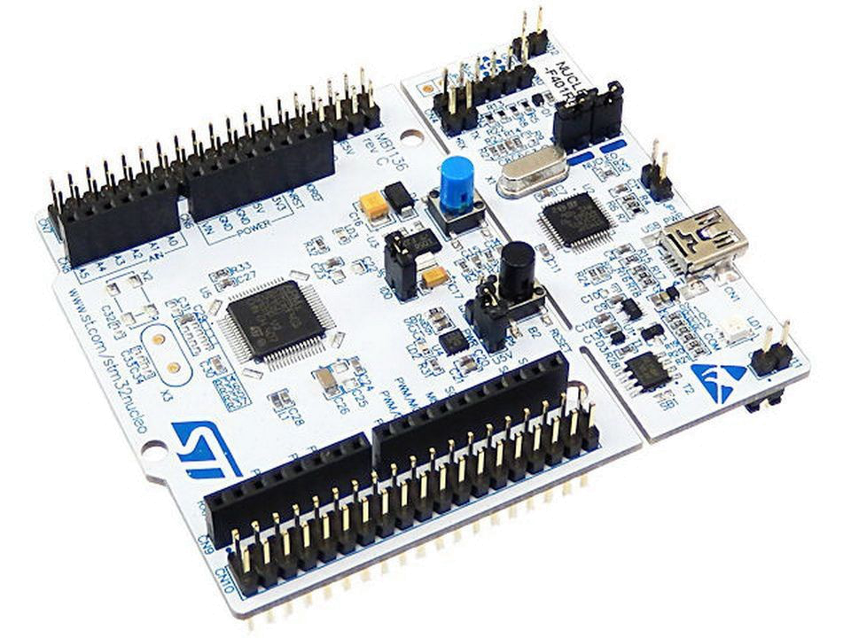
THESIS CONTRIBUTION
I built a continuous learning framework for ARM cortex microcontrollers (using STM32 MCUs). The framework is:
Easy to attach at the end of pre-trained models
Able to generate self sustainable models (fine tune + learn new classes)
4 state-of-the-art algorithms have been implemented
Everything is deployed on two MCUs for two classification applications
Gesture recognition
Image classification
5

Slide 7
STRATEGIES
6

Slide 8
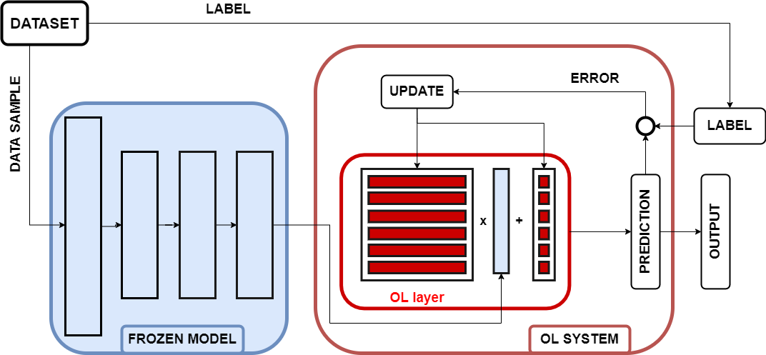
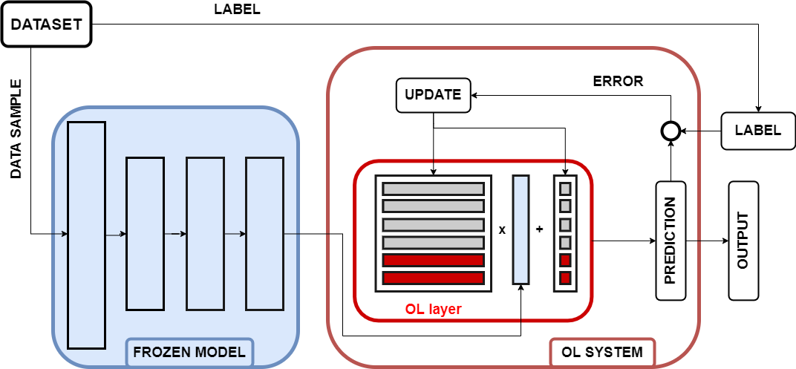
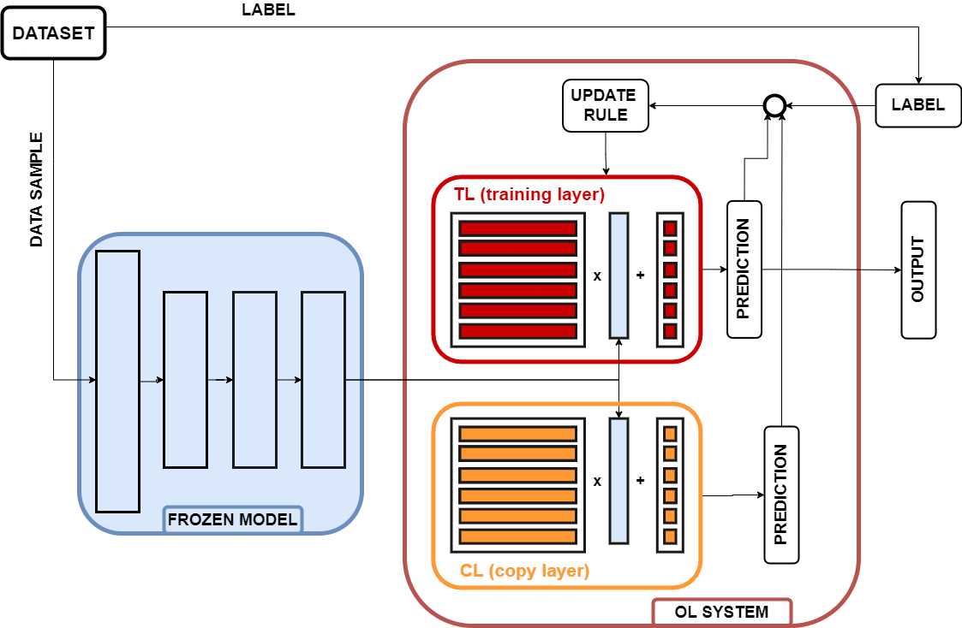
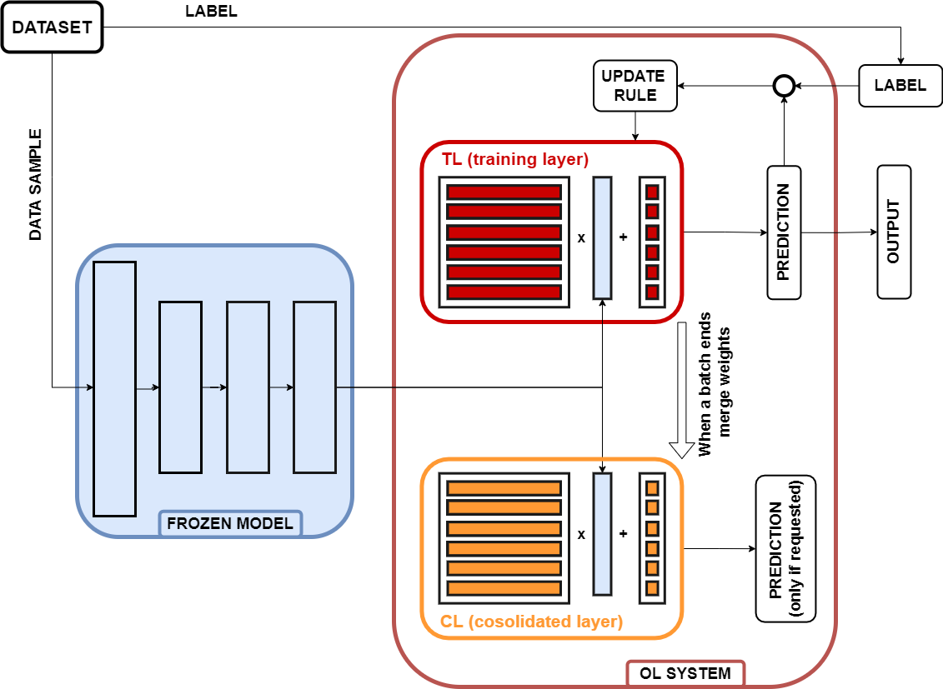
STRATEGIES
TinyOL
TinyOL V2
Tiny Online Learning
Tiny Online Learning Version 2
Fast
Light
Easy
Vulnerable
Fastest
Light
Easy
Not opimized inference
LWF
CWR
Learn Without Forgetting
Copy Weight with Reinit
Easy
Strong against forget
Double inference
Double memory
Easy
Strong against forget
Sometimes double inference
Double memory
6

Slide 9

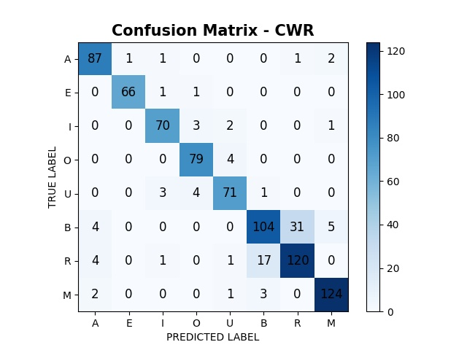
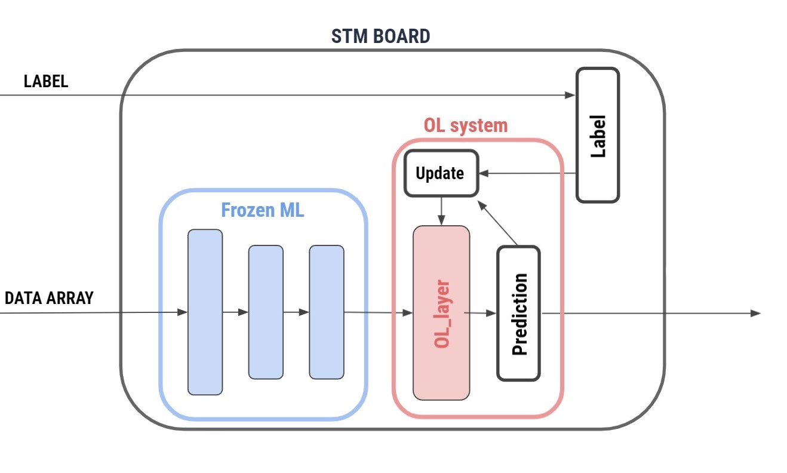

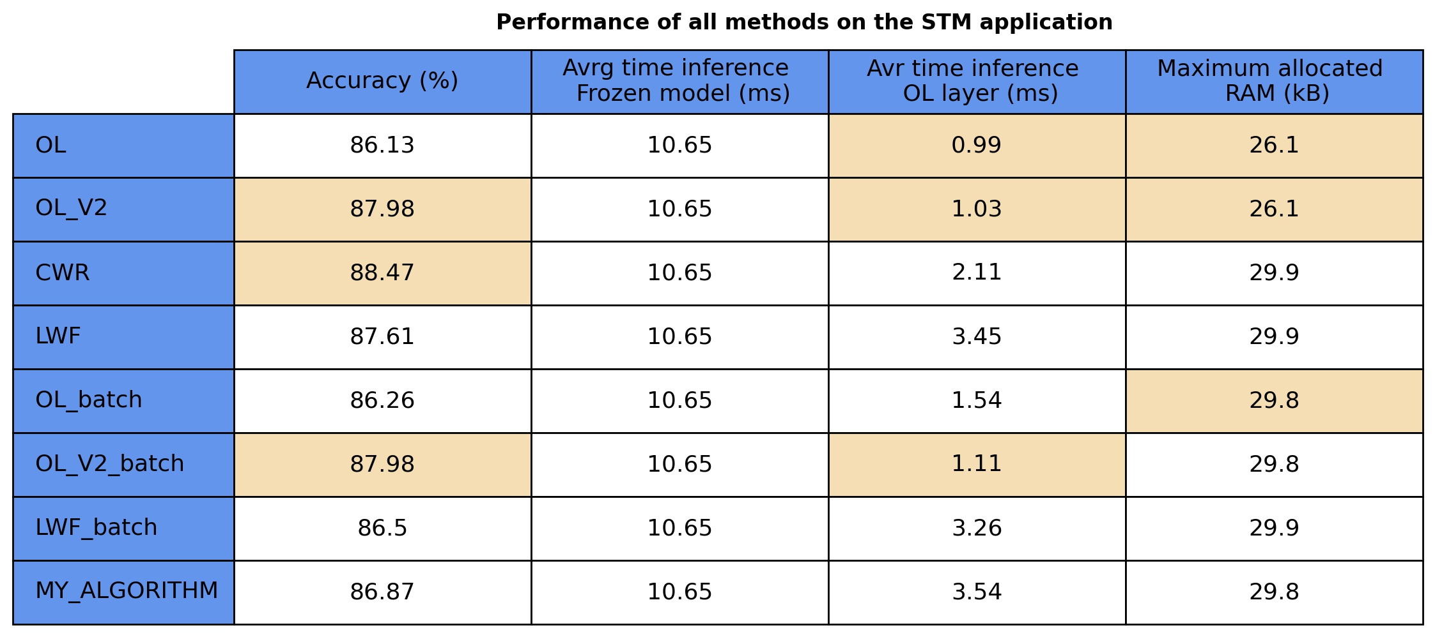
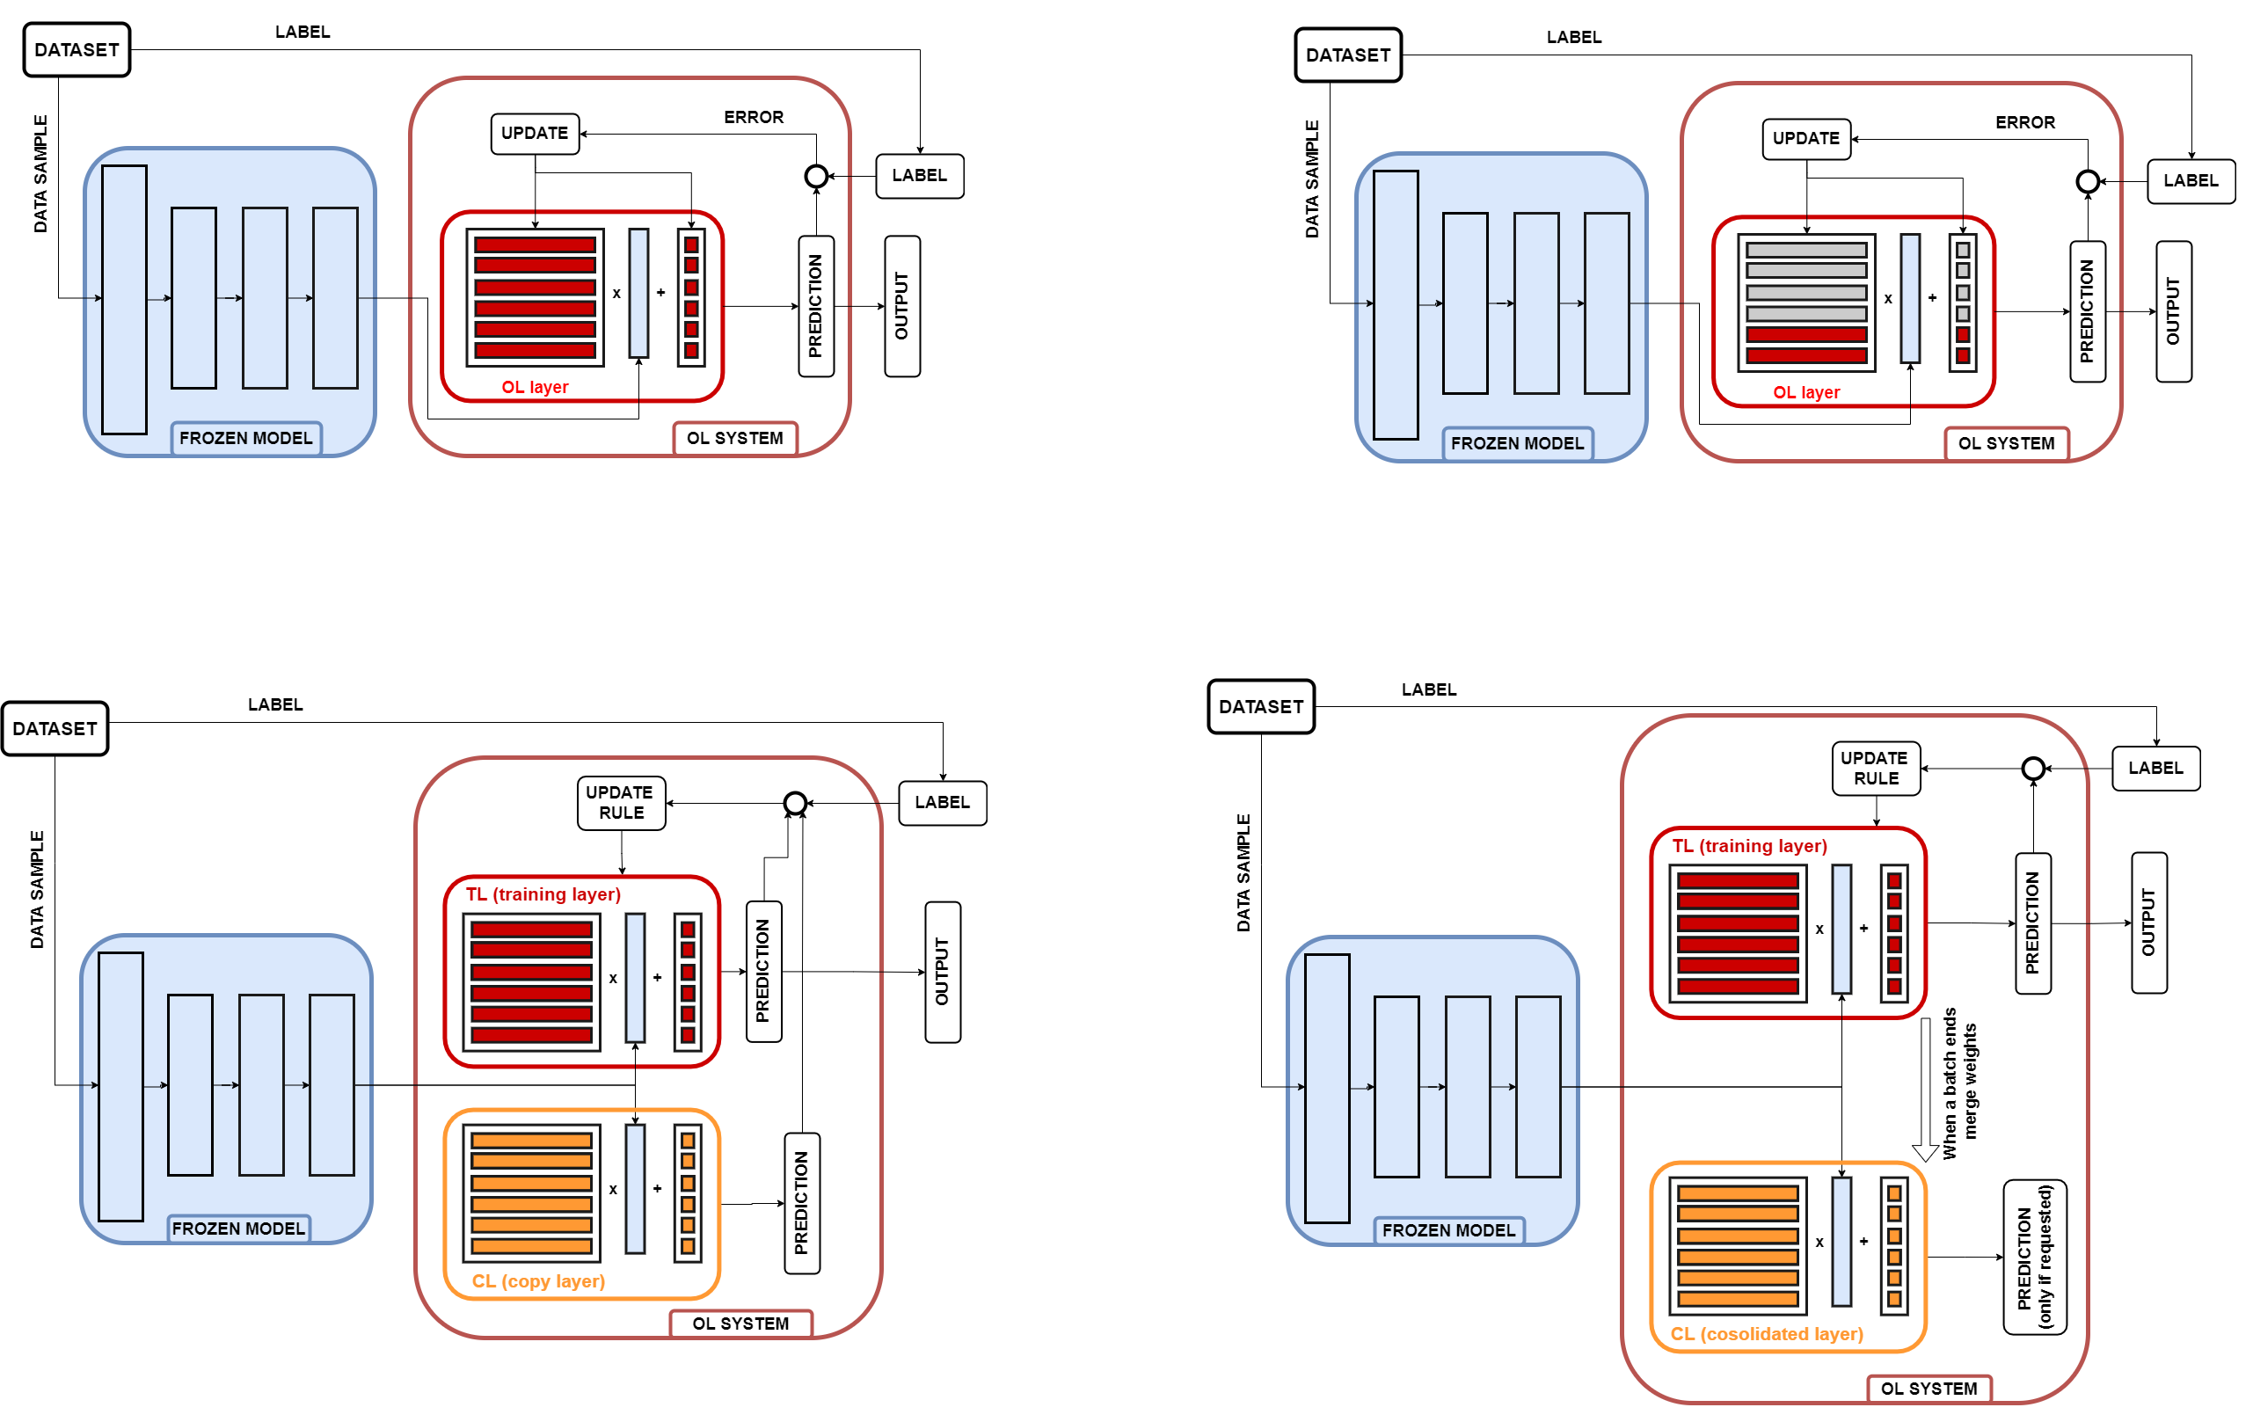


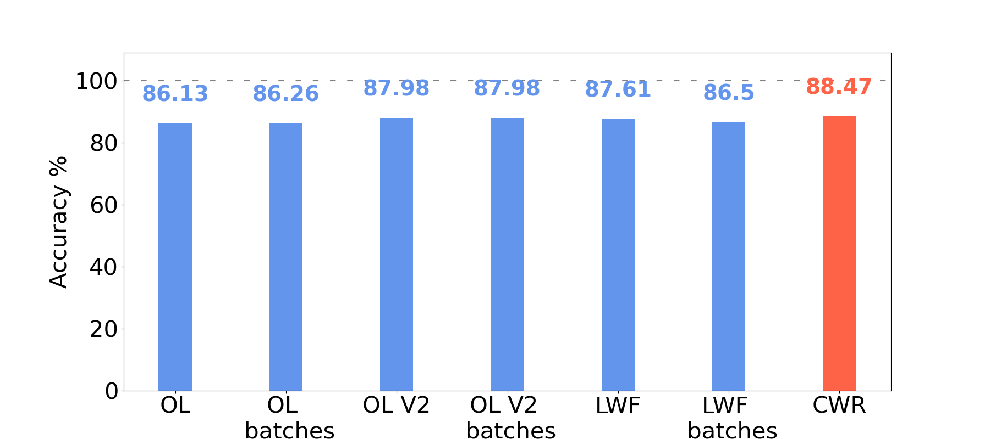
METODOLOGY
4 STRATEGIES
01
02
03
FRAMEWORK IMPLEMENTATION
LAPTOP SIMULATION
PERFORMANCE TESTING
7

Slide 10
GESTURE RECOGNITION
05
04
DEPLOYMENT
ON MCU
06
IMAGE CLASSIFICATION
8

Slide 11
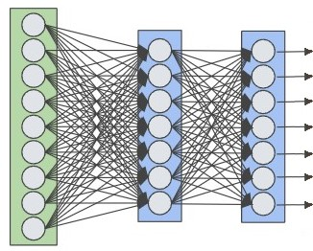
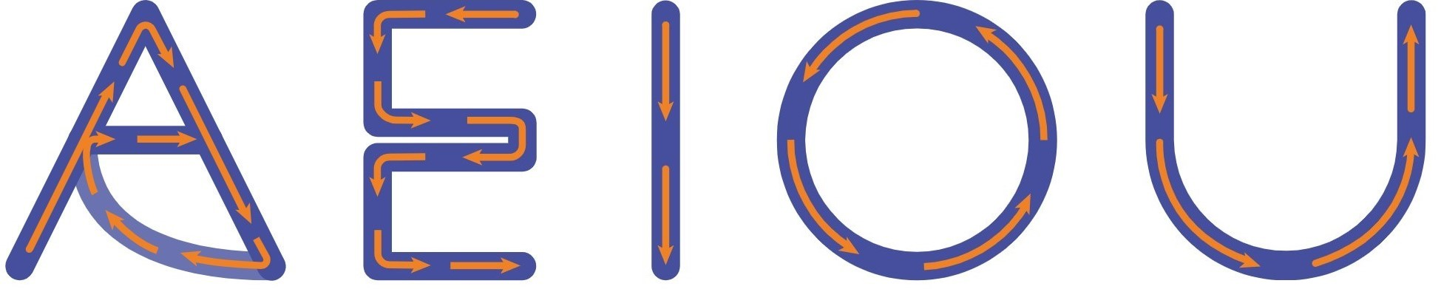
GESTURE RECOGNITION
True label
Data sample
FROZEN MODEL
04
A
E
DEPLOYMENT
ON MCU
CL SYSTEM
I
True label
O
U
DATASET

Slide 12
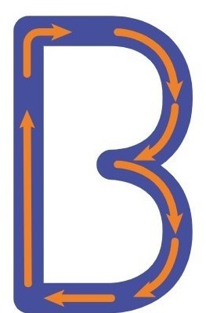

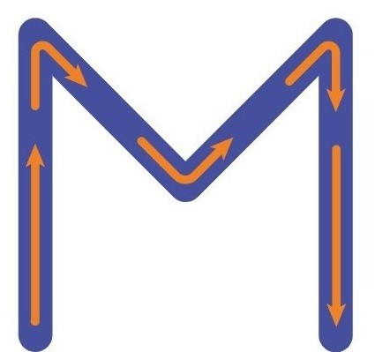
GESTURE RECOGNITION
True label
Data sample
A
FROZEN MODEL
E
04
I
O
DEPLOYMENT
ON MCU
CL SYSTEM
True label
U
B
R
M
DATASET

Slide 13
GESTURE RECOGNITION
05
04
DEPLOYMENT
ON MCU
06
IMAGE CLASSIFICATION
9

Slide 14
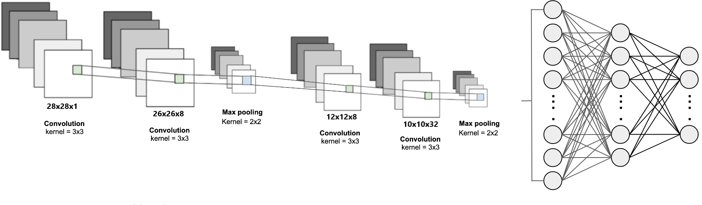

True label
Data sample
FROZEN MODEL
0
1
2
CL SYSTEM
True label
3
4
04
5
DEPLOYMENT
ON MCU
DATASET
IMAGE CLASSIFICATION
10

Slide 15
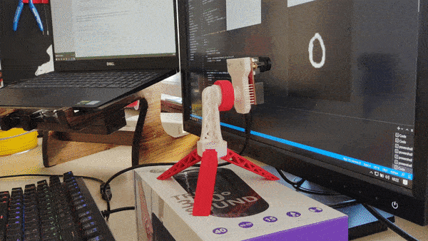

True label
Data sample
0
1
FROZEN MODEL
2
3
4
CL SYSTEM
True label
5
6
04
7
8
9
DEPLOYMENT
ON MCU
DATASET
IMAGE CLASSIFICATION
10

Slide 16
GESTURE RECOGNITION
05
04
DEPLOYMENT
ON MCU
06
IMAGE CLASSIFICATION
11

Slide 17
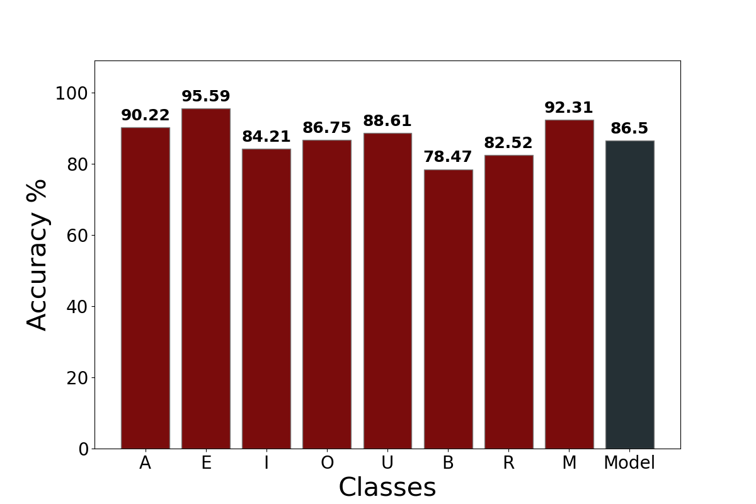
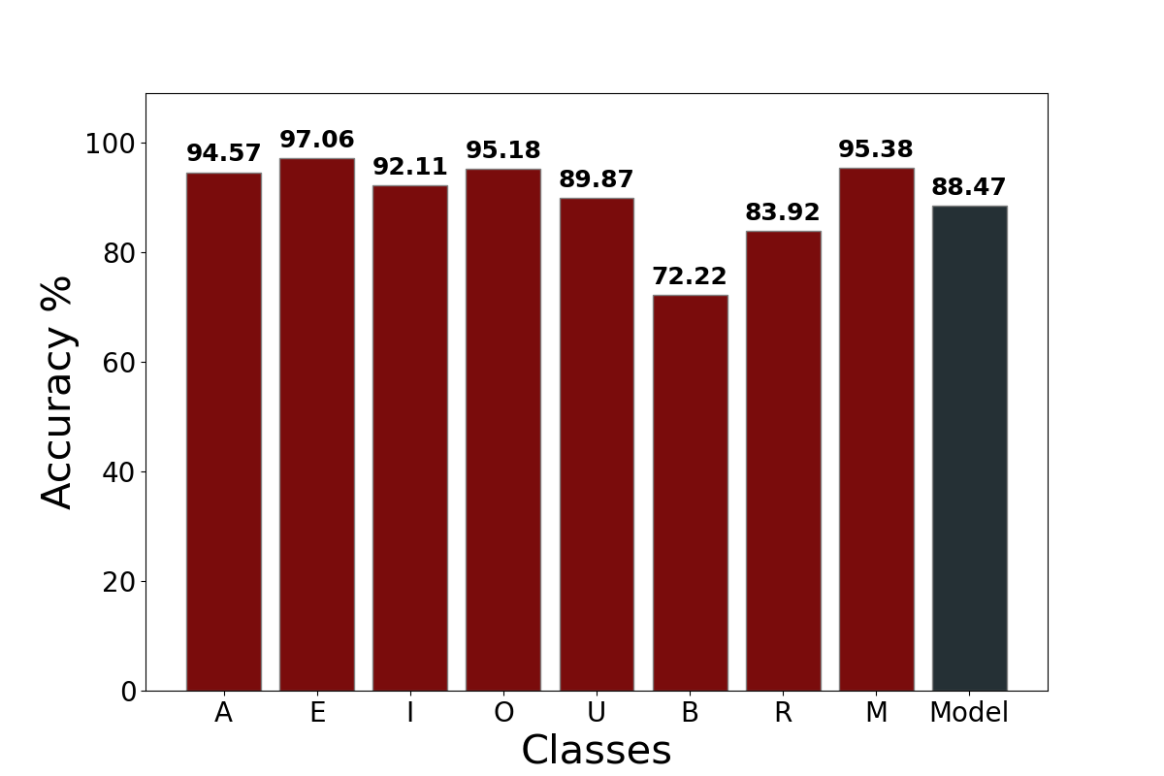
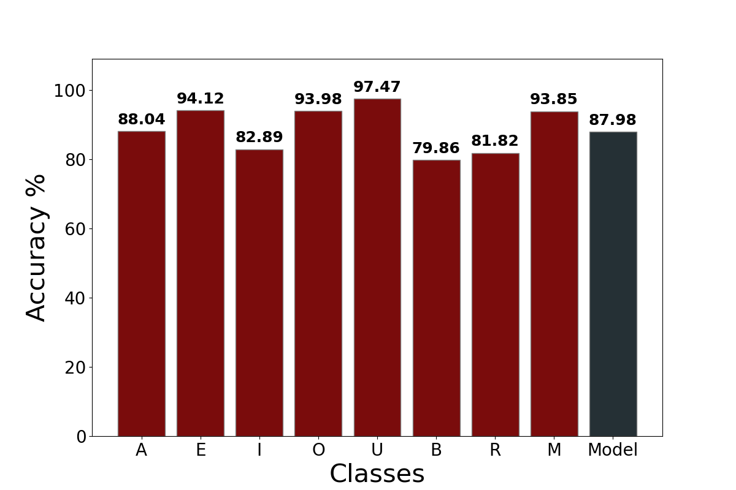
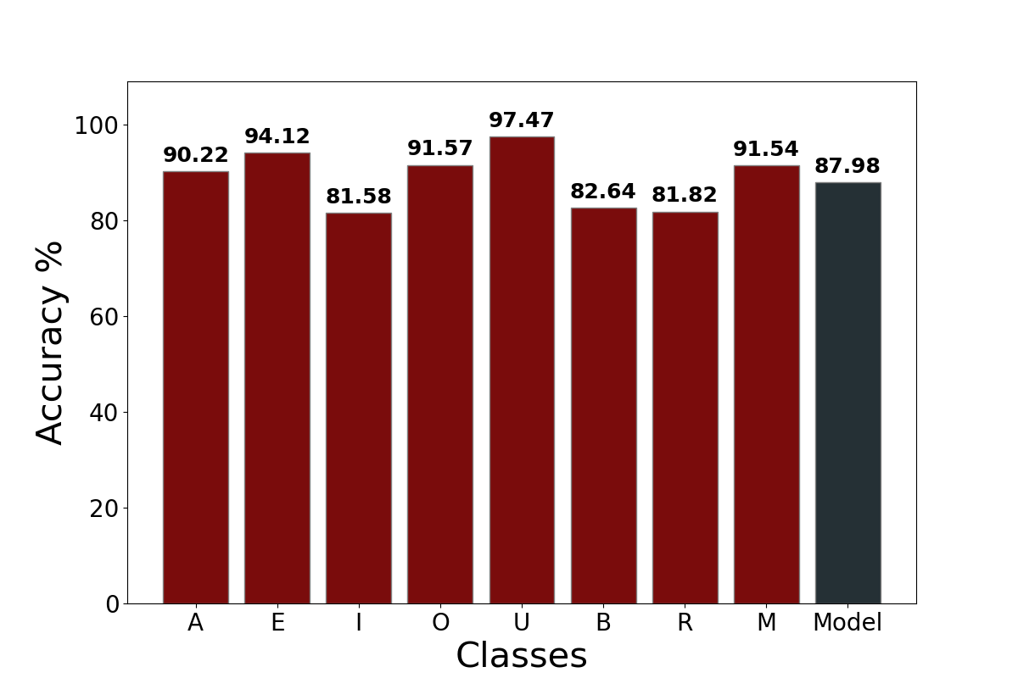
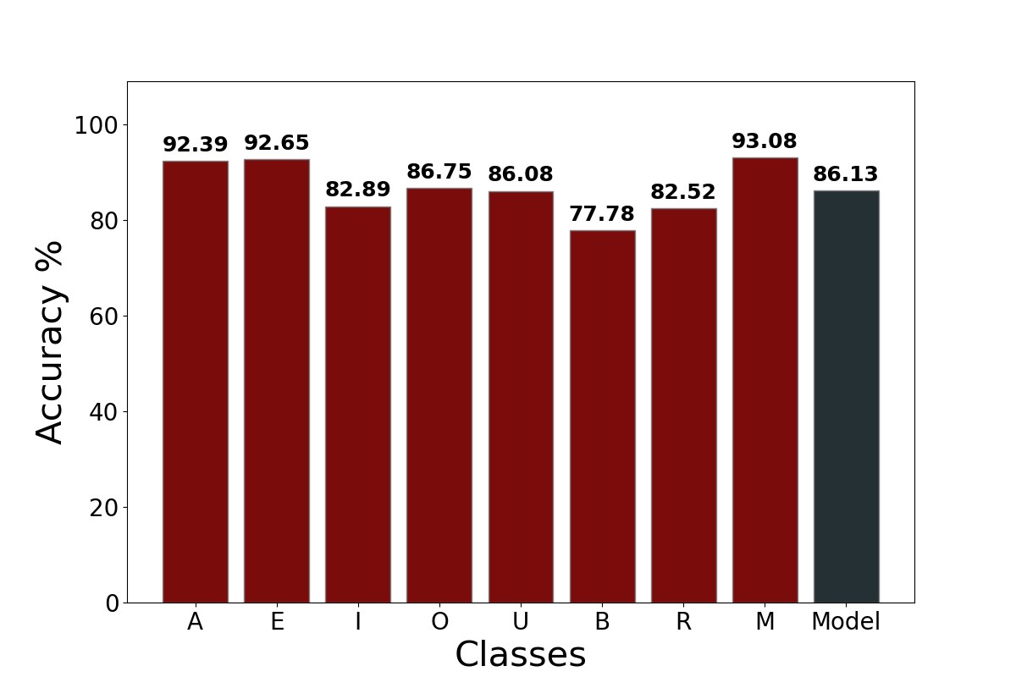
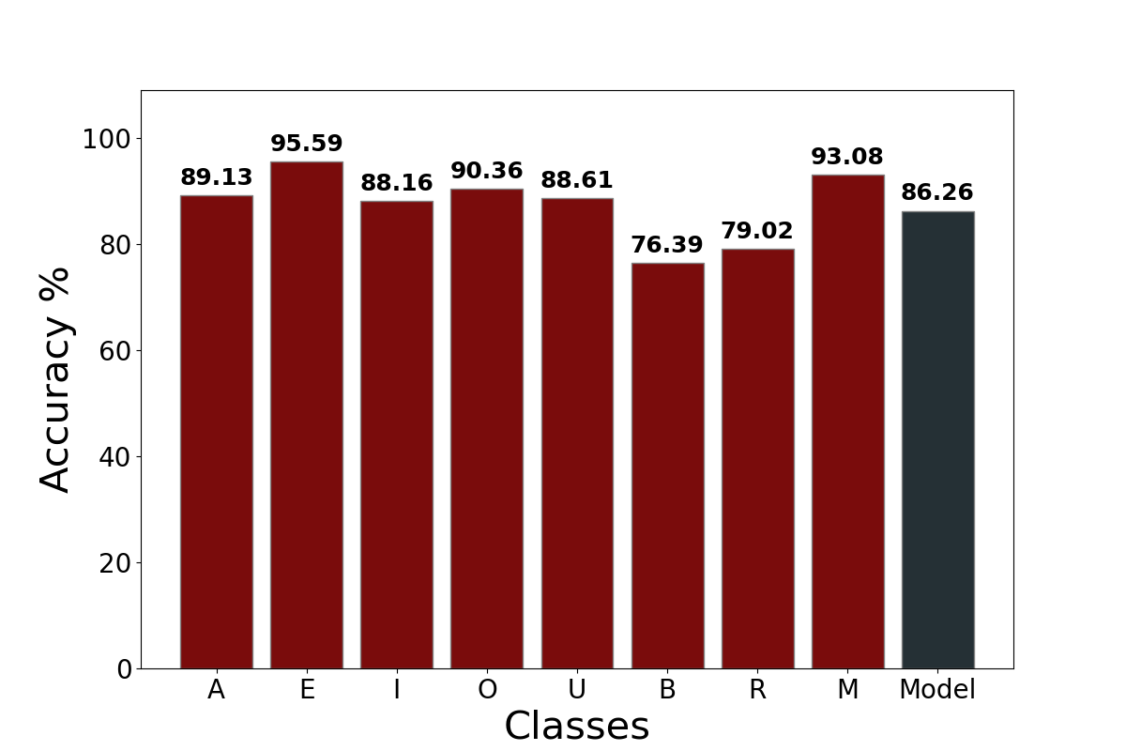
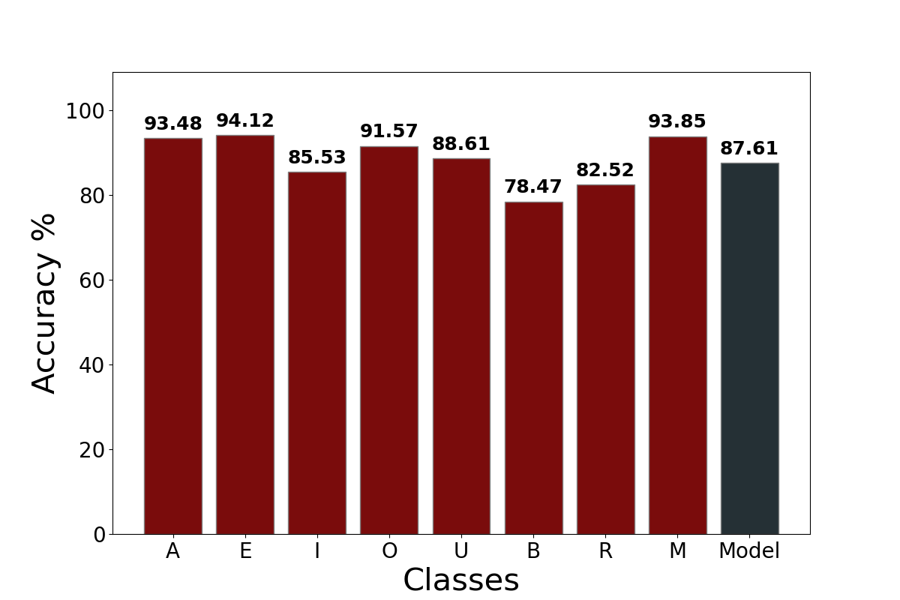
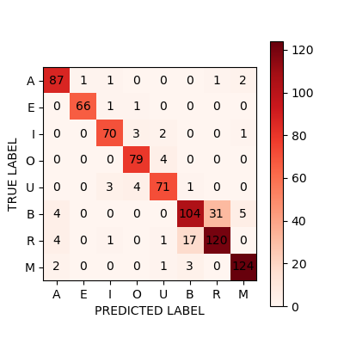
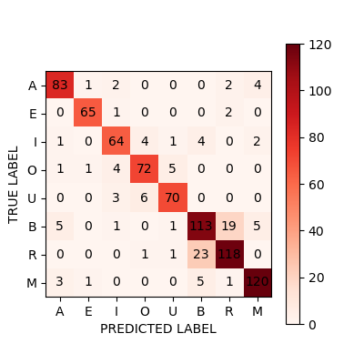
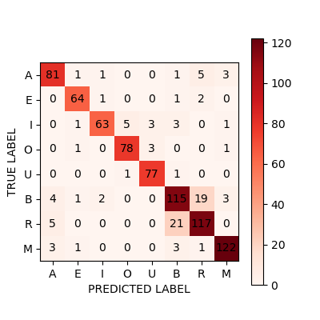
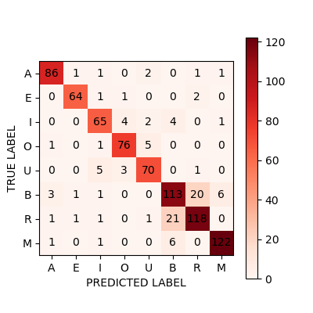
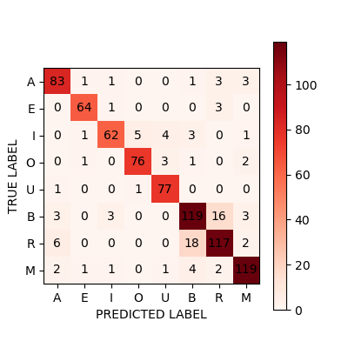
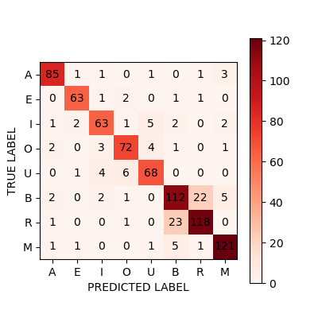
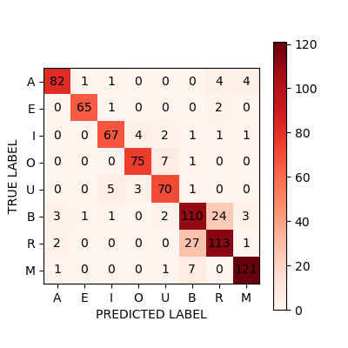
RESULTS: GESTURE RECOGNITION
ALGORITHM | ACCURACY [%] | INFERENCE TIME [ms] | PEAK MEMORY USE [kB]
TinyOL | 86.13 | 0.99 | 26.1
TinyOL batches | 86.26 | 1.54 | 29.8
TinyOL V2 | 87.98 | 1.03 | 26.1
TinyOL V2 batches | 87.98 | 1.11 | 29.8
LWF | 87.61 | 3.45 | 29.9
LWF batches | 86.50 | 3.26 | 29.9
CWR | 88.47 | 2.11 | 29.9
WORST METHOD
BEST METHOD
12

Slide 18
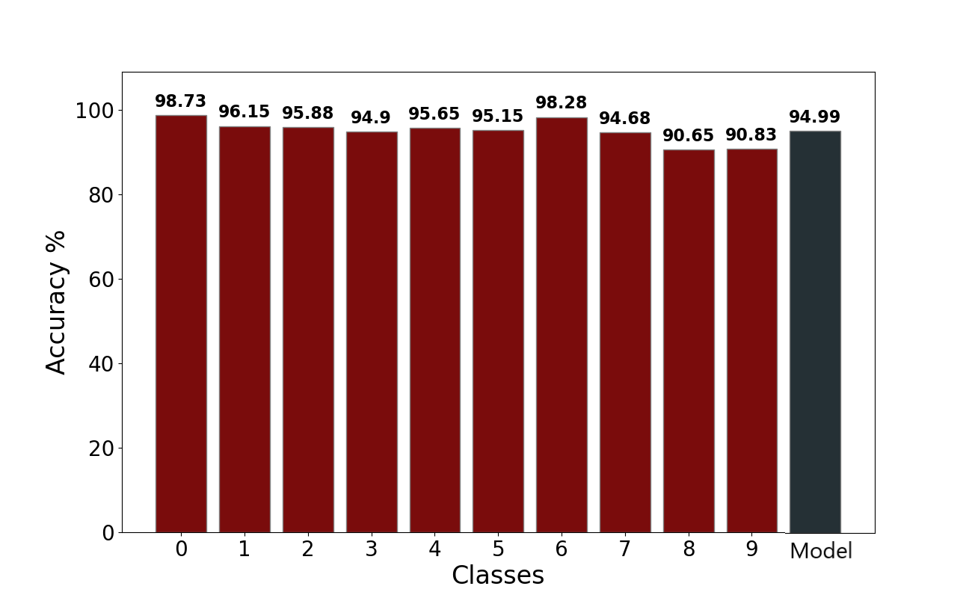
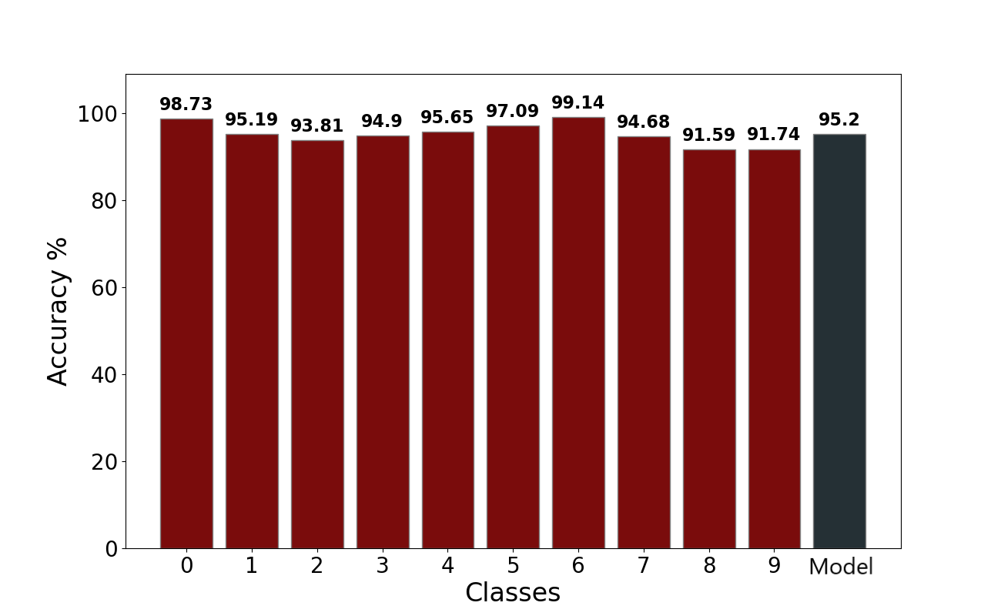
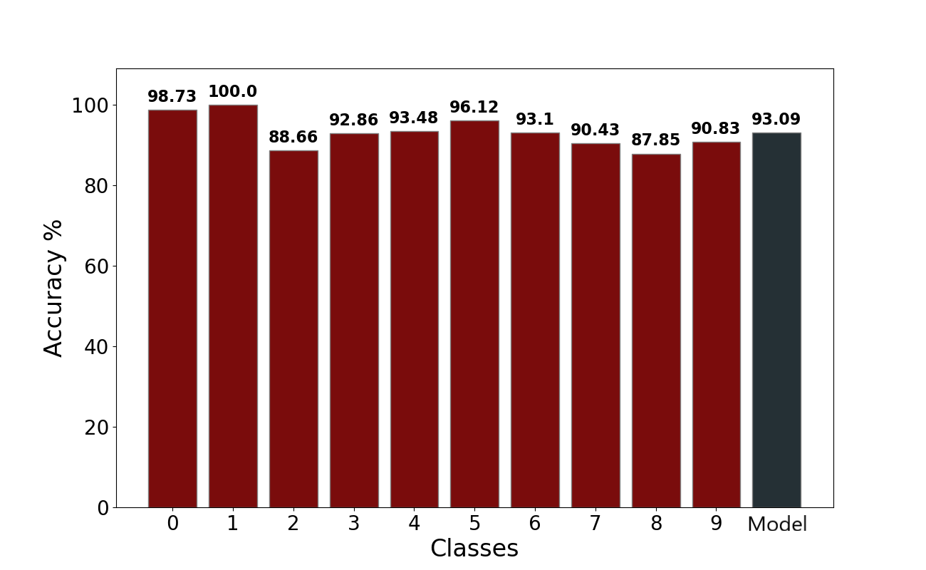
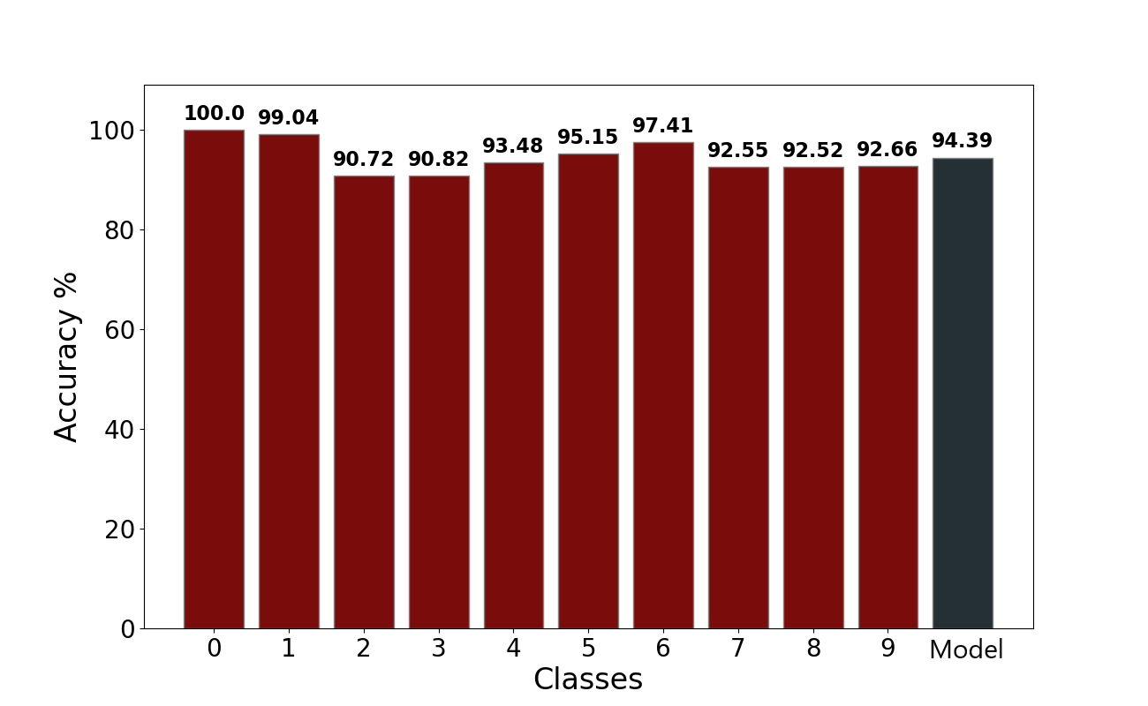
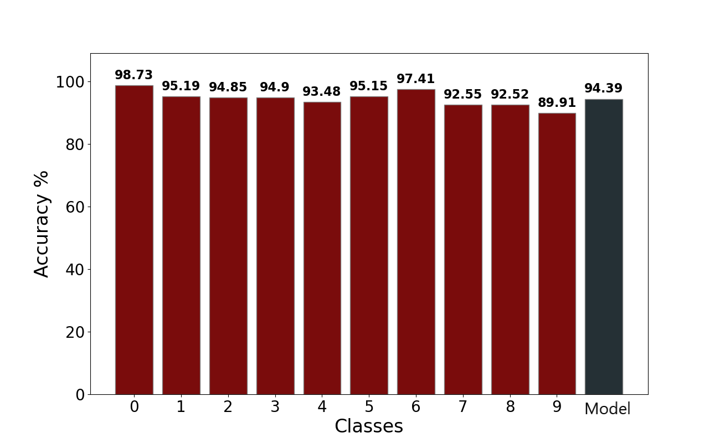
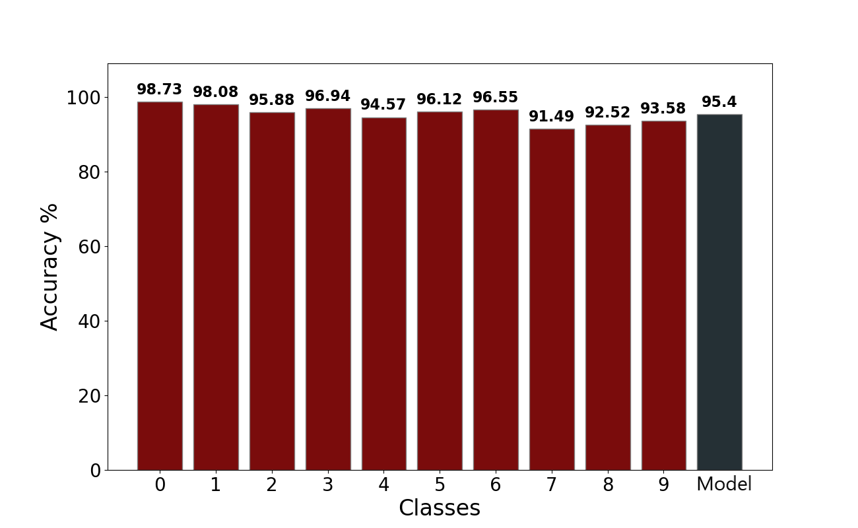
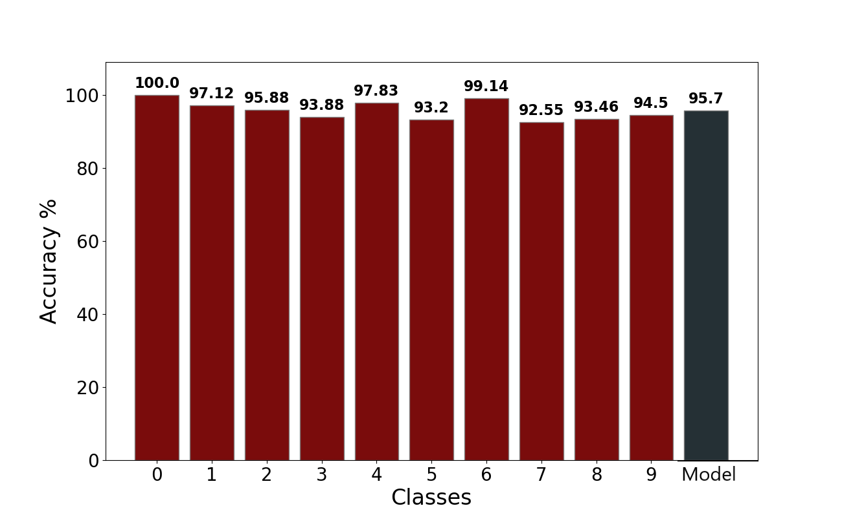
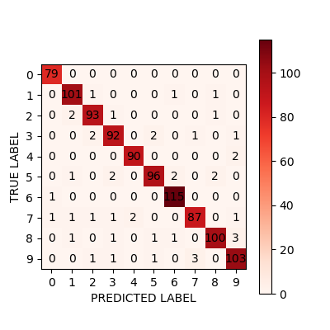






RESULTS: IMAGE CLASSIFICATION
ALGORITHM | ACCURACY [%] | INFERENCE TIME [ms]
TinyOL | 94.39 | 3.02
TinyOL batches | 95.40 | 3.35
TinyOL V2 | 94.39 | 2.13
TinyOL V2 batches | 93.09 | 4.24
LWF | 95.20 | 4.86
LWF batches | 94.99 | 5.20
CWR | 95.70 | 3.32
WORST METHOD
BEST METHOD
13

Slide 19


RESULT DISCUSSION
Continual learning has been
succesfully implemented on MCU
The tests were carried out in supervised settings
Final accuracy of the models is satisfiyng
There is always a drop in accuracy when compared to original
All algorithms are good for continual learning
Dataset is randomized, so catastrophic forgetting is damped
Best strategy is CWR
14

Slide 20




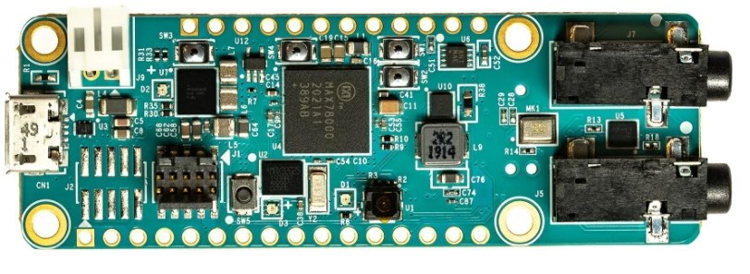
CONCLUSIONS & FUTURE WORKS
CL STUDY
DEPLOYMENT
TESTING
Framework implementation with 4 state-of-the-art algorithms
Porting of the framework on 2 hardwares
Of the performances with classification of images and gestures
UNSUPERVISED
MAX 78000
Unsupervised scenario better resembles real-life applications
Application on a third device Work in progress..
15

Slide 21
THANKS FOR YOUR ATTENTION
Do you have any questions?

Slide 22
COMPARISON OF INCREMENTAL ON LINE LEARNING ALGORITHMS FOR GESTURE AND VISUAL SMART SENSORS
Relator Davide Brunelli Co-relator
Andrea Albanese
Student Alessandro Avi

